Slide 1
Predicting Ticket Value for Big Mountain Resort

Slide 2
Problem Identification (1)
Problem: How can Big Mountain Resort identify the dollar impact of controllable factors on ticket value, as soon as possible, in order to understand how to price tickets, maximize return on business investments, and cut costs with minimal impact on ticket revenue?
Criteria for Success: Management is able to identify how each controllable factor impacts the value of a ticket, allowing them to price tickets based on the value provided by Big Mountain’s facilities, identify areas of investment to maximize ticket value, and determine where to cut costs with minimal impact on ticket value.

Slide 3
Problem Identification (2)
Potential Limitations:
Analysis/modeling used data on 27 features from 330 resorts. The best predictors of ticket value may be outside of this dataset.
Only revenues are considered – management will have to consider expenses to determine if modeled scenarios will be profitable.

Slide 4
Recommendations & Key Findings
Recommendations:
Immediately raise ticket prices to $83.83
Immediately close a single run to cut costs
Gradually raise prices to $94.22 (while examining the impact of each successive price increase)
Key Findings:
Closing multiple runs is potentially profitable
Increasing vertical drop by 150 feet is potentially profitable

Slide 5
Modeling Results & Analysis (1)
Big Mountain’s Current Facilities:
Current facilities support a ticket price of $94.22 (error was $10.39)
Accounting for error, it should be safe to charge $83.83/ticket
$94.22/ticket can be viewed as an ultimate target price

Slide 6
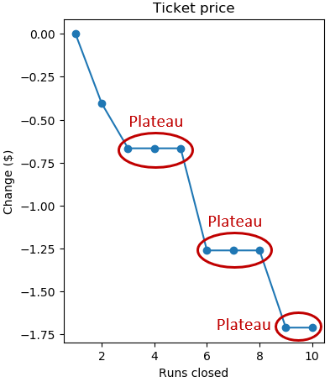
Modeling Results & Analysis (2)
Run Closures (max. 10 runs):
Closing a single run will have no impact on ticket price
Multiple run closures will impact ticket price. Cost/Benefit Analysis will be required.
Plateau effect: ticket price change levels off at certain points
Ex. Closing 3,4, or 5 runs has an identical impact on ticket price

Slide 7
Modeling Results & Analysis (3)
Increase Vertical Drop by 150 Feet (requires a new run and a new chairlift)
Supports an increase of $1.99/ticket
Generates additional $3,482,500 annually (assuming 350,000 visitors and average stay of 5 days)
Must account for cost of building/operating a new chairlift

Slide 8
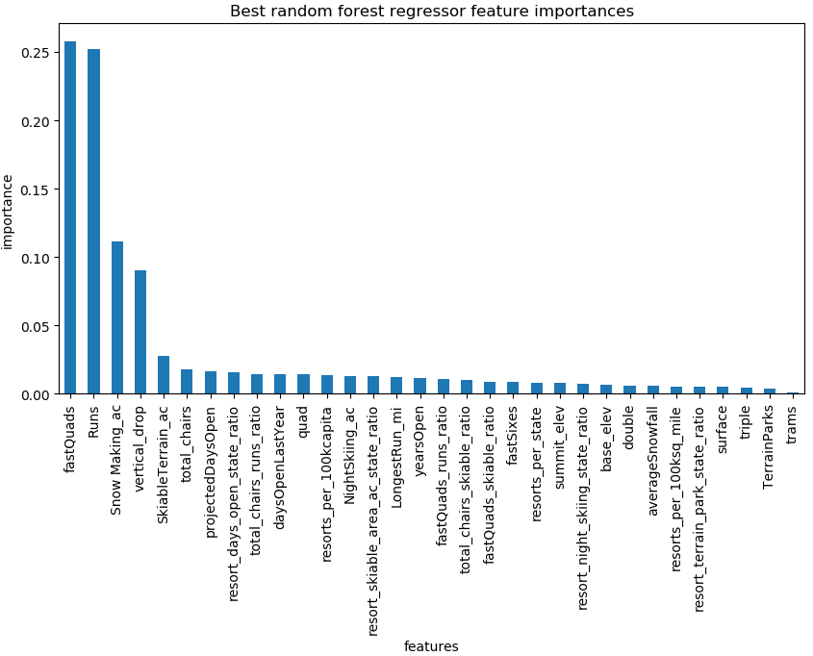
Modeling Results & Analysis (4)
Features considered important by the model can be seen in the figure.
This information can be used to generate new scenarios to model

Slide 9
Summary & Conclusion
Immediately charge $83.83/ticket and close one run
Explore further ticket price increases
Investigate multiple run closures (cost of open runs?) and vertical drop increase (cost of new chairlift?)
Explore other feature/value scenarios using the model
Potential for future modeling:
Fine-grained visitor data
Customer feedback (reviews/surveys)

